Slide 2
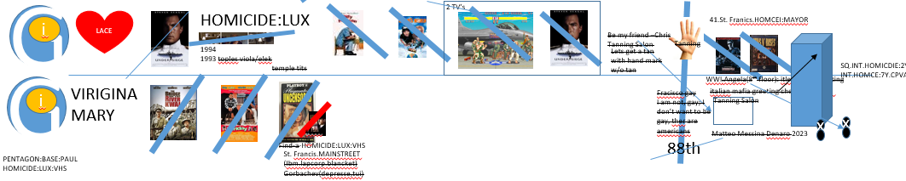
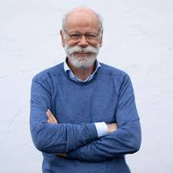
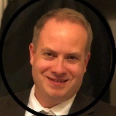
FBI
partner
development
WAR.HOMICIDE:LUX:COINTOWN:screen 1:”yesterday-ddr” 2000
Karooke:
Thomas-is-dieter
Spy ricardo
VIRGINA.MARY
KING.Federal
Louisiana
G.God’s Eye. Crooked Nipple: !Crooked Nipple(Stephanie, oversized)
WAR
Suicide Bomber(iCPVA:Offsite) IPX !HOMICIDE:KING(bruce king).WAR
Yesterday
Hard-to-find
SQ.Gov.Schwazzenegger
8:06am 7/31/2023
2013 Visa -> 10Y -> 2023
CHECKPOINE CHARLIE
Visa Incidents:
Silence of Lambs
HIPPA – gorbahce(lan,ATOMCLOCK(tim,touch).nonPoliceRTALogical()
fintech sacramento heilos mattias
webmaster@cola5.de
O’Reilly
J5
CPVA.nonPoliceContact[]
Web Master
https://www.linkedin.com/in/matthiasheilos?

Slide 3
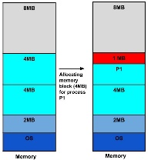
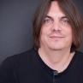
FBI
partner
development
9:16am 7/31/2023
2013 Visa -> 10Y -> 2023
CHECKPOINE CHARLIE
iCPCPV(Visa Incidents)
Silence of Lambs
HIPPA – gorbahce(lan,ATOMCLOCK(tim,touch).nonPoliceRTALogical()
SQ.INT.HOMICEI:2Y at chuch VIRNIG:MARY kill you
2pm 7/31/2023 hand coodinates
x
Phil(kim).concustion
Response anger known hand gestesture (concution)
Docs
(41)
8:06-9:16
1:10 MINUTES; 10Y
LIFE.DEALTH PENATLY PREA.§187.EXT
41.Fragmentation Operiaotin System
And On-Call!
…

Slide 4
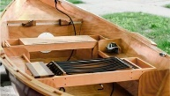
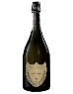
FBI
partner
development
Sandr-o
“Winning”
Two-halfmen
Bui
nurse
!nurse
home assessor boat bui
Elebeth:nonPoliceDA~.lsint(built a boat small in swedish for ppool)

Slide 5

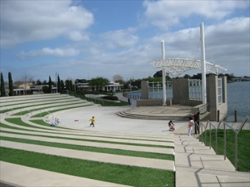
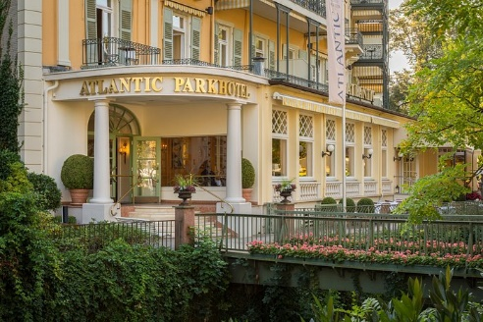
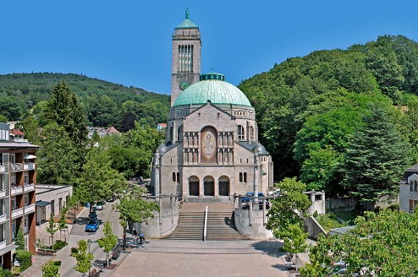
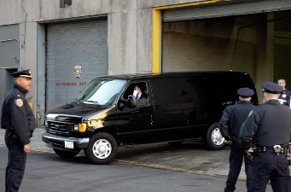
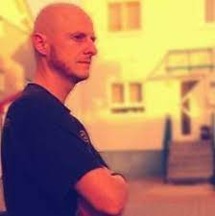
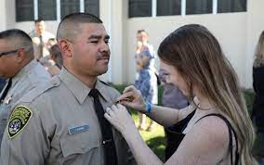
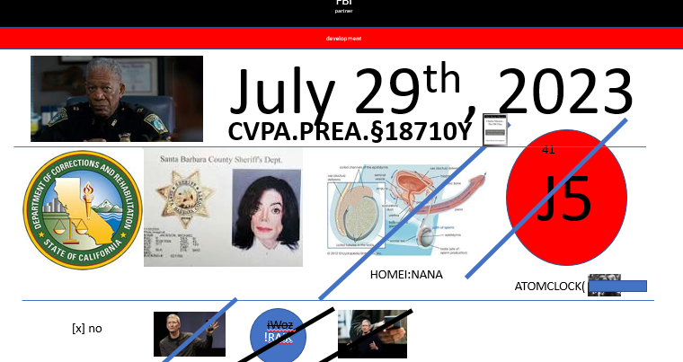

FBI
partner
development
IBM Partner
Cam Solutions LLC
Client HHS
Managing Director: Jason N. Meiers
CPVA.development
J5
katolishe kirsche baden-beaden
docs
docs
!raik
webmaster@cola5.de
pinebrook
2015 Dec.ATOMCLOCI(ProstG)
santa calra Hermosa research
https://www.universalmusic.com/
webmaster@jackson5.com

Slide 6
FBI
partner
development
$1B+ / month (more)
$1B+ / month (more)
$1

Slide 7
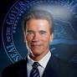

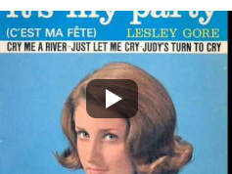
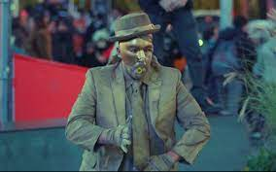
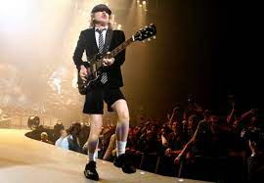

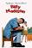

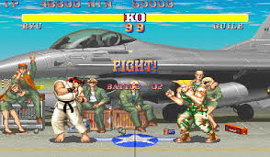

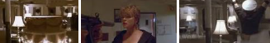
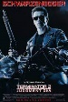


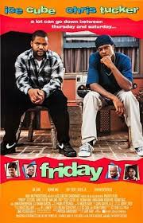
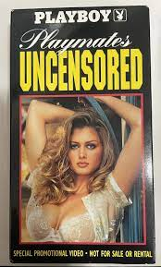
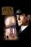
FBI
partner
development
COPYRIGHT
1D8726
PENTAGON:BASE:PAUL
HOMICIDE:LUX:VHS
FEDEARL DEFAULT
“Birthday Suite”
LACE
G
HOMICIDE:LUX
2 TV’s
i
LACE
41.St. Franics.HOMCEI:MAYOR
Be my friend –Chris
Tanning Salon
Tanning
1994
1993 toples viola/elek
temple tits
Lets get a tan with hand mark w/o tan
SQ.INT.HOMICDIE:2Y
INT.HOMCE:7Y.CPVA
G
VIRIGINA
MARY
WWI.Angela(8th floor): itlen mafia greeting
i
Fracisco gay
I am not, gay; I don’t want to be gay, ther are americans
italian mafia greeting cheek kiss knifie
Tanning Salon
schulz
Matteo Messina Denaro 2023
x
x
Find-a-HOMICIDE:LUX:VHS
88th
PENTAGON:BASE:PAUL
HOMICIDE:LUX:VHS
St. Francis.MAINSTREET
(Ibm.lapcorp.blancket)
Gorbachev(depresse,tui)

Slide 8

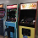
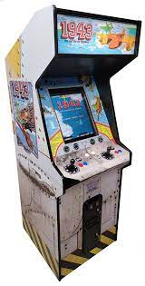
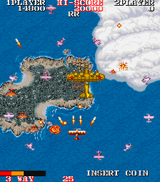
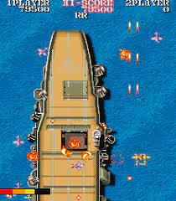

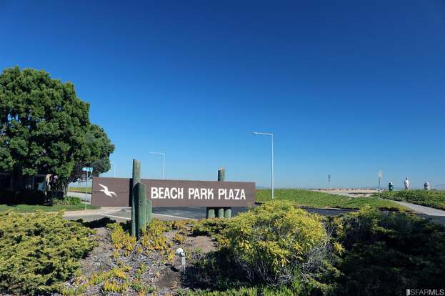
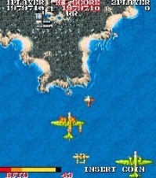
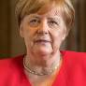



FBI
partner
development
A5
IPX
CPVA.HW5.DEA(crack)
1942,
42 dr roos
2004
Al kaida
adam
2014 ATOMCLOCI(CPVA)
FBI:WMD Office shooter ?HOMCEI:BROTHER

Slide 9

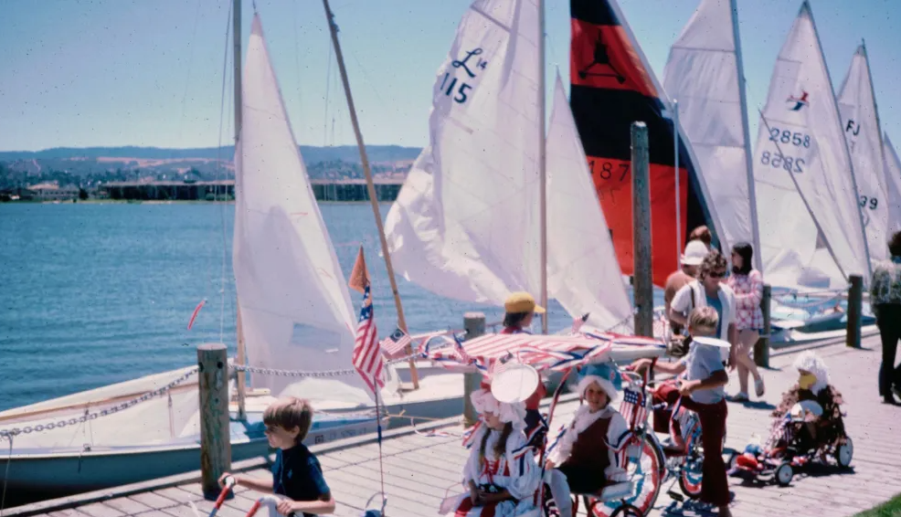
FBI
partner
development

Slide 10
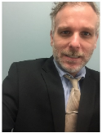
FBI
partner
development
?

Slide 11
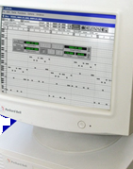

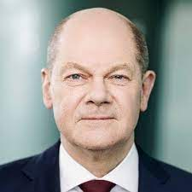
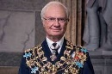



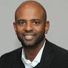

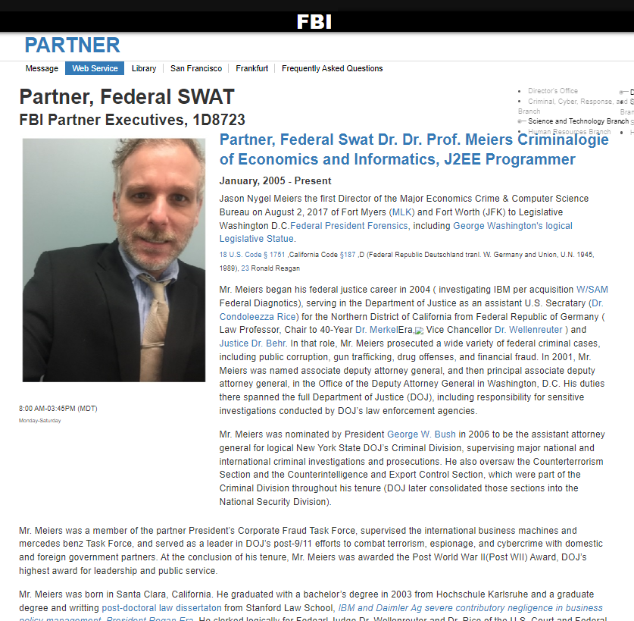
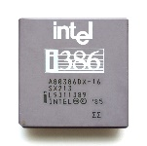
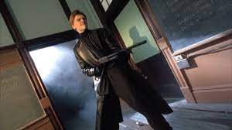
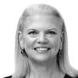
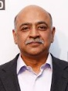
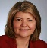
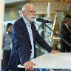


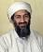

FBI
partner
development
1994 30Y SQ.angela
PENTAGON “PAUL” !PETER
LIVE!
HOMCI:BUNNY….
v2.extortion
March 23, 1994
HOMCIDE:LUX
April 23, 1994
Pentagon Base Paul Barack( IT ) William(Bill) Lovelace
G
LACE
i
CPVA.!AVABILITY
ATOMCLOCK(!HOMIDE:BILL)
FACEBOOK
§Accomplish
§Bystander
1994 Process description
KING.eva.braun
41
FBI:WMD for schools
POLIZEI Child: Felix Wagner
Social Secur Admisnt Child: Daniel rehicne
X386, x486
Sell house: Bring back 1 million
Sandy Hook
Angel-o angela-a, sandr-o, sandr-a
Auschwitz: Sandy
Costco: what happened in that cabin?
In you face; 1990
1994 angela(elke): jack off (age:14) at breakfast
2001 cosco wieland
2010 cabin mein kampf
Tui/ltur
Al kaida flights
Thomas-is-dieter
ITERNET PAYMENTS ubaid. v2
Flights.CPVA.(clarity:employee;clarity:ca software)

Slide 12
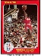
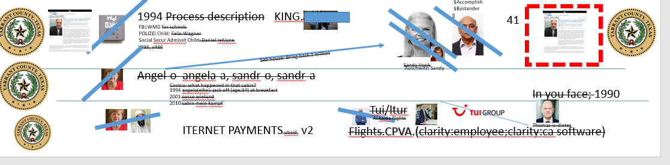

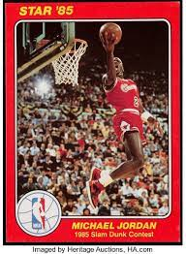
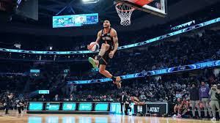
FBI
partner
development
CPVA(yougurt store)
MAINSTRE(Marin,jyll !jack.CPVA )
Angela.diesel=MARK(us).PREA
?
John Bitconi :HOCMI:LUX(twins)
ww2
raik
2014 -> 1991 HOCMI:SUNSTO(Kodak Gabriel, pankau, KING.JOPHSE.TERMNATOR(cisoc.mtonrign)
Wall view
Big Deciotions HOCMIE:7
IPX nonPocieTExa.NSA IPX aFd.ext.marx
Ext MARKETING
1990: In your face
NAVY.SAYLOR
!raik
Bloopers
Glu.raik

Slide 13





















FBI
partner
development
1995
nonPoliceChurch.NSA.nonPolcieMonitoringLogical.000.tw.pns
wealth, actions, … payments, donations, !paymetns, !donations
MEMBERSHIP
i.e. God.nonPolciCTXLogical{
}
i.e incident.eval.duration
WWI.andreas
2005 ibm.invite
St. Anselmo. Chruch fees lamb
GOD.MAINSTRET(PENTIANG.VIRIGN.MARY)
TORT-II.NAME CHANGE
(freepizza)
000.41
Movies duign CPVA virgin sacrafie
TORT-1
TORT-III.(?) ?dr.PostDoc
SQ.HOMCIDE:2Y
angela
Cannot take the heat
Taek the hit
On-call.!AVAIBltTY
PREA.anil/anal
2008
2016
docs
41.Pbt.tshirt.drawer.2nd.floor.mr.rogers
16Y
MAINSTREET
HOMCIDE:LUX:VHS:STORE
17.7
etc…
Studio 1
DEC
Age: 17, 1997
17
Thomas-is-dieter
Kito,micheala
Leopold
Jason Meirs
December 1998
18Y

Slide 14







FBI
partner
development
The Advance Estimate of Second Quarter Real GDP
?
CPVA
D””
Ukraine
JFK:?HOMICIDE:BROTHER
(Goethe gymnasium
docs
Dweddiledump

Slide 15




















FBI
partner
development
Juges, Brac, Debory: lock refrigerator for Matherw (DEA(crack,malcom2/braley3)
Joephse
angela-bauer.JFK(PREA)
Matt(l.a)
farmer
IPX HOMICE:LUX: globus lux shopping store
KING. Platic shoes
!?
Ddr
clue
PENTAGON.emea.basf.chemicls.deere
HOMIC:LUX:VHS:STORE
Soviet union
VICTUM; ID PROFE 250lbs, Age 60, Itailen, Businessman
SQ.COLEMAN.FBI.INVESTION.HOMICIDE:IS-A-BELL
Mihceala, chemlves life deciease, hands
RELAY
JEANS
TORT-I
GDP
10:39am apple.division.mortocylc
Berny Sonny berger
HOMICDE:7
The Advance Estimate of Second Quarter Real GDP
WWI.us-shop: TORT-I
Aple.davison.daniel.kojte
UN
Kim bui
FBI
ibm
v2
1
2
PENTAGON.emea.deere
CPVA.SQ.FBI.INEVESTION(manson)

Slide 16














FBI
partner
development
Vice Presidnet Germany
41.“RONSON”
SQ.ATOMLCI(time) “match”,hooligans
1990: In your face
FBI
kim
v2
POLICE
VOLLEBALL BLOND
HBO
PREMIERE
1990
HOMCEI:LUX.v2.majeski daugheter
SECUIRTY VIDEO GAME ARCADE(18)
Satureday Offenbach
HOMICDIE:LUX
Spectator,Soccer Intertered
WWI.flag(unknown)
?
Hooligans fence( empty)
nakedin england police chasing man over field
Flashers
x
Boggies
x
13
7
7,10
ASUCHIWTZ(0.1 mountain view ( dieter diema,blong dick; st frnaci pubic hair/! not)
GOD(simon,guido)
Walmart
/Werkauf
7
13/16
11
7

Slide 17
FBI
partner
development
v2

Slide 18

FBI
partner
development
v2
“BLACK”
<delete>
avg

Slide 19




FBI
partner
development
$12,0000 DM
0.1 Gov.Swch(twinere,puma)

Slide 20






FBI
partner
development
$0.25 cents

Slide 21




FBI
partner
development
$12,0000 DM
41.JOEPSHE
Disneyland 1955
opening
0.1 Gov.Swch(twinere,puma)

Slide 22

FBI
partner
development
$12,0000 DM
11:25
11:26
MOTHER
0.1 Gov.Swch(twinere,puma)
… alg

Slide 23






FBI
partner
development
ATOMBOM(hahn, Otto-han-str 3)
MATHEW(?HOMICDIE:BOTHER): Auschwitz
HOMICE:LUX
1991 Febrayr
NAVY.SAYLOR.TYSON
1988
0.001
Gov. Scwh. Sieme tiwnn @head
1987

Slide 24
FBI
partner
development
Nineteen hundred forty three
19:43 15 minuts 8pm
1980
41.1990
->2023

Slide 25

FBI
partner
development
1943
1942,
42 dr roos

Slide 26




FBI
partner
development
“a federal agent or police officer who enforces the laws regarding illicit sale or use of drugs and narcotics.”
PETERSSON, JASON
A.K.A
JASON NYGEL MEIES
IBM SWAT

Slide 27

FBI
partner
development

Slide 28







FBI
partner
development
“BUSTED”
docs
kahn

Slide 29
FBI
partner
development
Nineteen hundred forty three
19:43 15 minuts 8pm
1980
41.1990
->2023

Slide 30





FBI
partner
development
Johnny
nonPoliceRTALogial
41 21 jumpsteete
Depp
Horny redbull
MAINSTRET(Homcei:goodyar)

Slide 31




FBI
partner
development
“a federal agent or police officer who enforces the laws regarding illicit sale or use of drugs and narcotics.”
CHARTS
INTERUPTS
1986 volleyball videogame arcade vs icelance
sound
!icevollbally
“eni” town mpoen
Recyling.eva.braun

Slide 32


FBI
partner
development
$12,0000
1990
0.01 HOMCEI:LUX:COINTOWN:INTRESTOWN

